Slide 1

Cincinnati Reds Hackathon
By: Adam Gehr, Brogan Berkey, Josh Knapp, and Liam Jennings

Slide 2
Introduction
Starting pitcher innings are on the decline
How can teams use their pitching depth more efficiently and effectively?
Important steps of analysis:
Regression
Linear Regression
Stepwise Regression
Decision Tree
K-Folds Cross Validation
Notes:
Brogan

Slide 3
Filtering Data
Remove pitchers with low innings counts
Accounts for injuries
Prevents frequently-optioned players from influencing data
Use basic statistics to create a baseline
Only want to include top 75% in Innings Pitched
Relief pitchers with less than 19.1 IP (first quartile) in a season are removed
Starting pitchers with less than 40.8 IP (first quartile) in a season are removed
Notes:
Adam

Slide 4
wOBA and Data Cleaning
Batting Average Against and WHIP are influenced by factors other than just pitcher and batter performance
How can we fix this?
Replace these variables with wOBA
Issue: Fangraphs and Baseball Savant names had spelling discrepancies
Had to recode Fangraphs data so we could bind wOBA from Statcast to Fangraphs
Notes:
Adam

Slide 5
Selecting Variables
K% - Strikeout Percentage
BB% - Walk Percentage
BABIP - Batting Average on Balls in Play
LOB% - Left on Base Percentage
wOBA - Weighted On Base Average
GB% - Ground Ball Percentage
LD% - Line Drive Percentage
GB to FB - Ground Ball to Fly Ball Rate
EV - Exit Velocity
LA - Launch Angle
Barrel% - Barrel Percentage
Hard% - Hard Hit Percentage
Notes:
Josh

Slide 6
Stepwise Regression
Why we used linear regression?
To determine which variables are statistically significant
Variables have normal distribution
Forward BIC
BIC is more stringent on the number of predictors than AIC
Used other models to confirm variable significance
F-statistic and t-values
Notes:
Liam

Slide 7
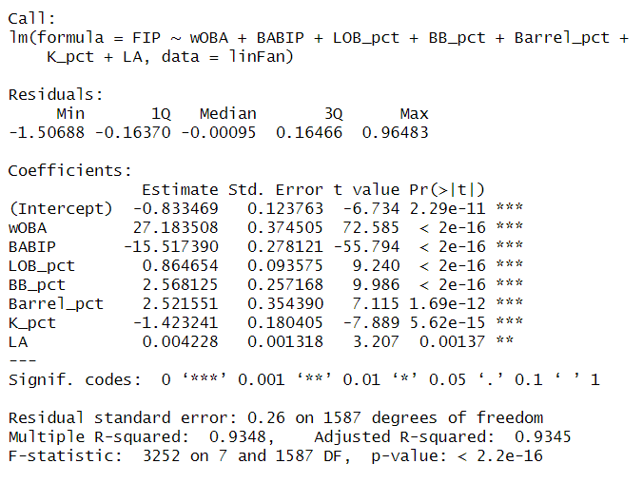
Notes:
Liam

Slide 8
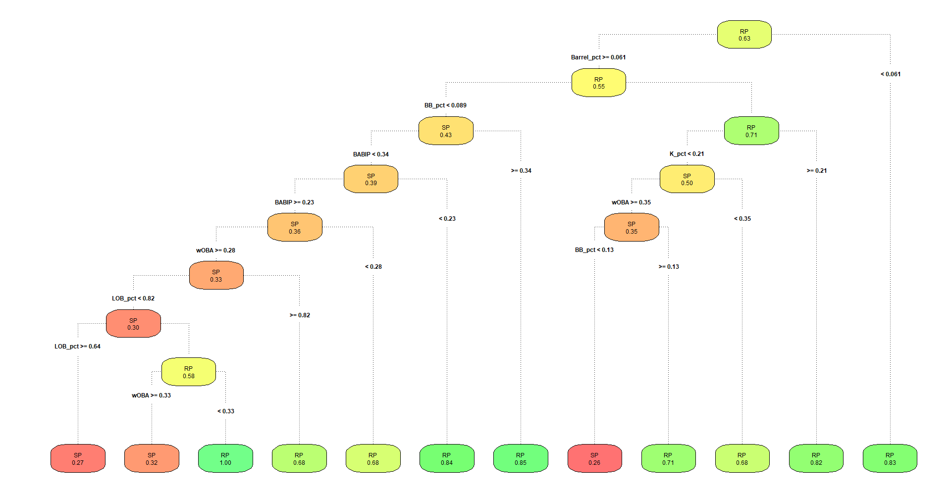
Notes:
Brogan

Slide 9
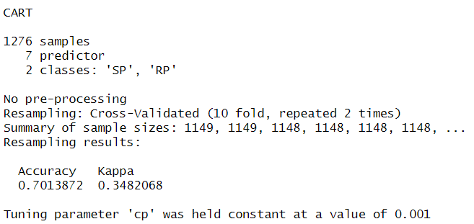
Validation of the Model
Fold 1
Test | Train | Train
Train | Test | Train
Train | Train | Test
Confusion matrix
Accuracy: 71.47%
Improvement over no information rate
K Fold Cross Validation
10 folds
Accuracy: 70.14%
Fold 2
Fold 3
Notes:
Liam

Slide 10
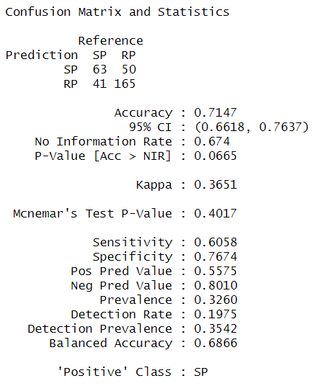
Notes:
Liam

Slide 11
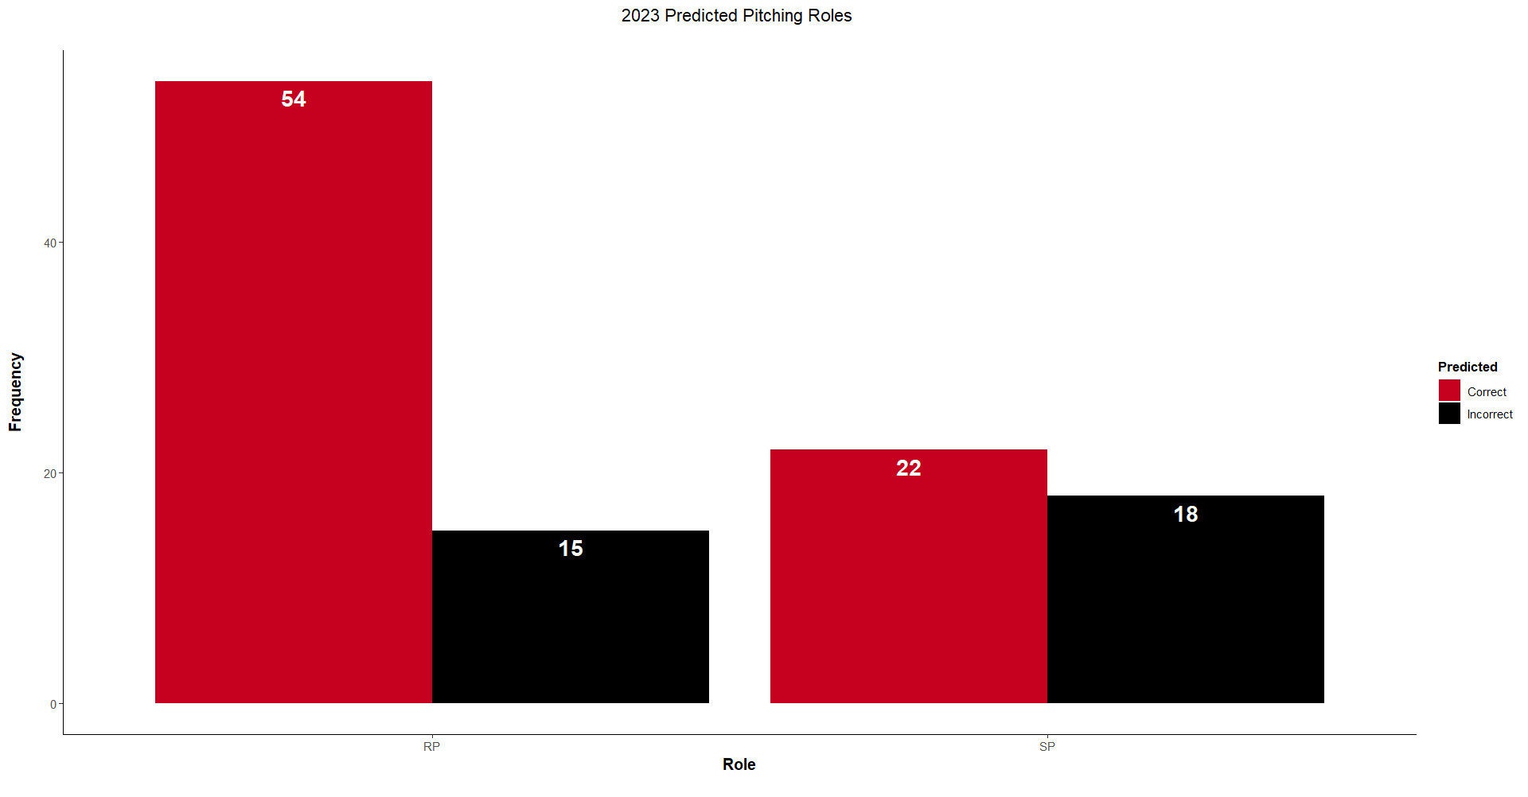
Notes:
Liam

Slide 12
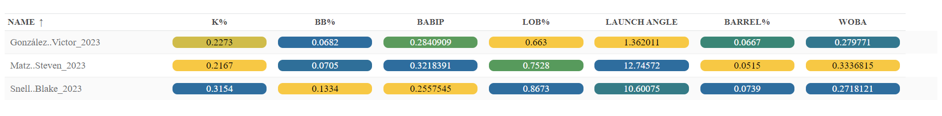
Pitcher Selections for Role Change
Notes:
Josh/Adam

Slide 13
Questions?

